Slide 1
CPSC 131 Data Structures Concepts Unordered Containers / Hash Tables
Dr. Anand Panangadan
apanangadan@fullerton.edu

Slide 2
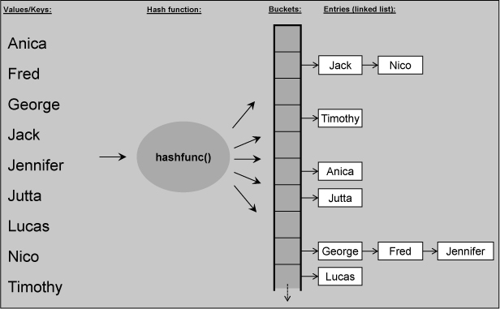
Unordered Containers / Hash Tables
Josuttis, The C++ Standard Library
Elements have no defined order
Finding an element is faster than associative containers

Slide 3
Unordered Containers
Josuttis, The C++ Standard Library
In unordered containers, elements have no defined order
If you insert three elements, they might have any order when you iterate over all the elements in the container.
If you insert a fourth element, the order of the elements previously inserted might change.
The only important fact is that a specific element is somewhere in the container.
Even when you have two containers with equal elements inside, the order might be different.
Think of it as like a bag.

Slide 4
Unordered Containers
Josuttis, The C++ Standard Library
Unordered containers are typically implemented as a hash table.
Internally, the container is an array of linked lists.
Using a hash function, the position of an element in the array gets processed.
The goal is that each element has its own position so that you have fast access to each element, provided that the hash function is fast.
Multiple elements might have the same position because such a fast perfect hash function is not always possible or might require that the array consumes a huge amount of memory.
For this reason, the elements in the array are linked lists so that you can store more than one element at each array position.

Slide 5
Unordered Containers
Josuttis, The C++ Standard Library
Major advantage of unordered containers
Finding an element with a specific value is even faster than for associative containers.
The use of unordered containers provides amortized constant complexity, provided that you have a good hash function.
However, providing a good hash function is not easy

Slide 6
A constant time data structure?
5
How long does it take to find an entry in a data structure?
Linked lists: O(n)
Balanced trees (AVL): O(log n)
Can we get to O(1)?
An array can get values in O(1) if
Keys are the same as array index
1
15
11
20
1
5
11
15
20
1
5
…
20

Slide 7
A constant time data structure?
An array can get values in O(1) if
Keys are the same as array index
Disadvantages:
Requires keys be unique integers in the range 0,1,…, N-1
wastes a lot of space if the number of entries are much smaller than N
The hash table is an attempt to reach O(1) by:
converting keys into codes, which may not be unique
compressing codes into indexes within a reduced storage space

Slide 8
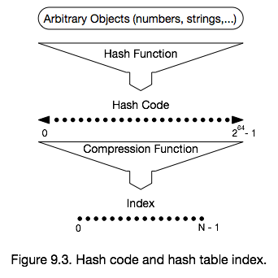
Main idea
Convert any data type into an array index
Hashing function

Slide 9
Hashtable
A hash table for a given key type consists of
Hash function h
Array (called table) of size N
When implementing a map with a hash table, the goal is to store item (k, o) at index i = h(k)

Slide 10
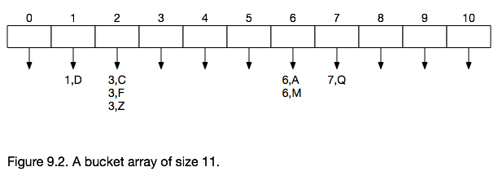
(Key, value) pairs
Reminder:
Keys are associated with values
For simplicity, only showing keys in figures

Slide 11
Compression function
Division method
Let N be the size of the array
To get array index of hash code k, do
Index = k % N
Take remainder after dividing k by N
Simple and commonly used
Example:
Let N=7
Key 20 goes into array index 20 % 7 = 6
array[6] = 20

Slide 12
Compression function
Insert keys 20, 25, 30 into a table of size 7
30
25
20
0
1
2
3
4
5
6

Slide 13
Compression function
Searching is similar to insert
search(25):
Calculate index(25) = 25%7 = 4
Look in array[4]
Cost of insert/search = O(1)
30
25
20
0
1
2
3
4
5
6

Slide 14
Compression function
Inserted keys 20, 25, 30 into a table of size 7
Insert key 16
30
25
20
16
0
1
2
3
4
5
6
Collision!

Slide 15
Collisions
When two different keys get assigned to the same table index
30 % 7 = 16 % 7 = 2
Solutions to deal with collisions
Chaining
Probing
Linear probing
Quadratic probing
Prevent collisions completely – Direct Hashing

Slide 16
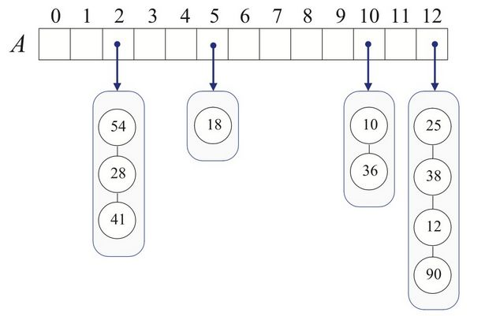
Chaining
Have each bucket hold a list (or a vector) of keys

Slide 17
Chaining
Have each bucket hold a list (or a vector) of keys
find(): calculate hash, search bucket’s list for key
insert(): calculate hash, insert key into bucket’s list.
remove(): calculate hash, remove key from bucket’s list

Slide 18
Chaining
Insert(23)? Note that N=13
23

Slide 19
Chaining
Have each bucket hold a list (or a vector) of keys
find(): calculate hash, search bucket’s list for key
O(n) worst-case
insert(): calculate hash, insert key into bucket’s list.
O(1) worst-case if duplicates allowed
O(n) worst-case if duplicates not allowed
remove(): calculate hash, remove key from bucket’s list
O(n) worst-case

Slide 20
Linear probing
Only have a single array
If bucket is occupied, search forward for a free bucket
Search is circular
when end of table is reached, wrap around to beginning
Search fails if starting point is reached

Slide 21
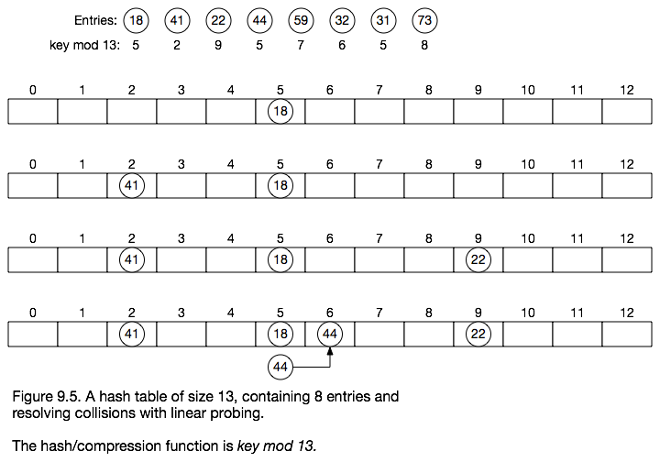
Resolving collisions with linear probing
A hash table of size 13, compression function: key % 13

Slide 22
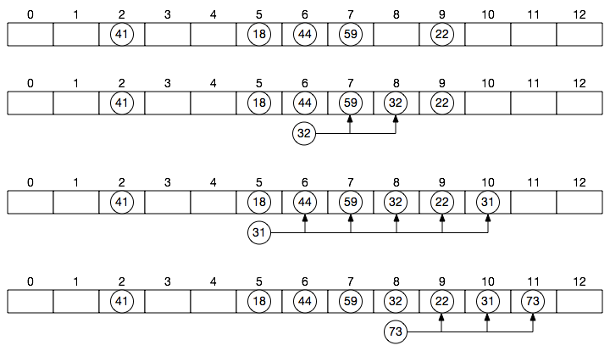

Slide 23
Values of “empty” cells
Two kinds of empty cells
Empty since start (E1)
Empty after removal of an element (E2)
Initially, all cells have value E1

Slide 24
Search with Linear Probing
Algorithm find(k)
i ← h(k)
n ← 0
repeat
c ← A[i]
if c == Ε1
return not found
else if c.key () == k
return c.value()
else
i ← (i + 1) mod N
n ← n + 1
until n == N
return not found
Consider a hash table A that uses linear probing
find(k)
We start at cell h(k)
We probe consecutive locations until one of the following occurs
An item with key k is found, or
An empty cell (E1) is found, or
N cells have been unsuccessfully probed

Slide 25
Insert with Linear Probing
Algorithm insert(k, value)
i ← h(k)
n ← 0
repeat
c ← A[i]
if c == Ε1 or Ε2
A[i].key ← k
A[i].value ← value
break
else
i ← (i + 1) mod N
n ← n + 1
until n == N
return hashtable is full
insert(k, value)
We start at cell h(k)
We probe consecutive locations until an empty cell (E1 or E2) is found, or
N cells have been unsuccessfully probed

Slide 26
Remove with Linear Probing
Algorithm remove(k)
i ← h(k)
n ← 0
repeat
c ← A[i]
if c == Ε1
return not found
else if c.key () == k
A[i] ← E2
return
else
i ← (i + 1) mod N
n ← n + 1
until n == N
return not found
remove(k)
We start at cell h(k)
We probe consecutive locations until until one of the following occurs
An item with key k is found, or
An empty cell (E1) is found, or
N cells have been unsuccessfully probed

Slide 27
Performance of Linear Probing
Colliding items lump together, causing future collisions to cause a longer sequence of probes
In the worst case, searches, insertions and removals on a hash table take O(n) time
The worst case occurs when all the keys inserted into the map collide
Load factor of a hash table α = n/N
How full is the hash table?
The load factor affects the performance of a hash table
Assuming that the hash values are like random numbers, the expected number of probes for an insertion with linear probing is 1 / (1 − α)
Recommendation: keep α < 0.5
At least half the table must be empty
Then, expected cost < 1/(1-0.5) = O(1)

Slide 28
Performance of Hashing
The expected running time of all the operations in a hash table is O(1)
In practice, hashing is very fast provided the load factor is not close to 100%
Recommendations:
keep α < 0.5 for linear probing
keep α < 0.9 for separate chaining
Applications of hash tables:
small databases
compilers
browser caches

Slide 29
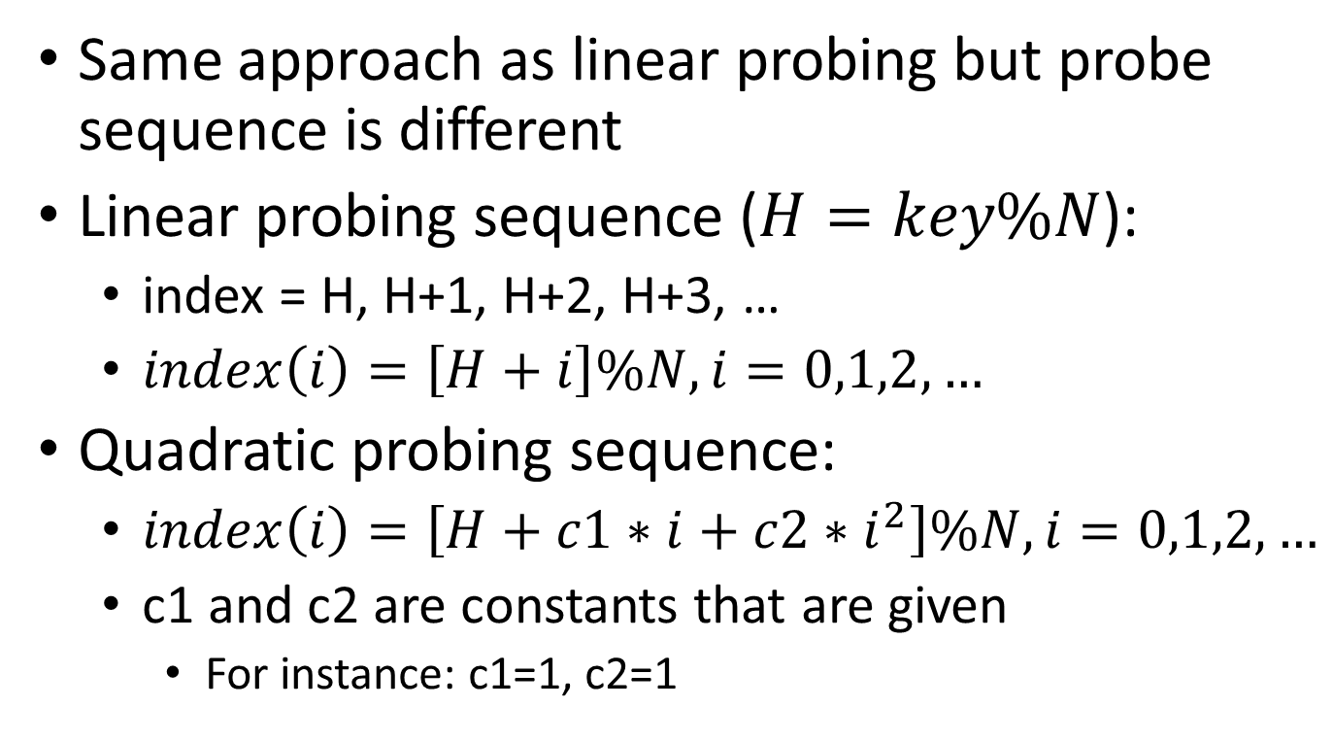
Quadratic probing
Same approach as linear probing but probe sequence is different
Linear probing sequence ($H=key\%N$):
index = H, H+1, H+2, H+3, …
$index\left(i\right)=\left[H+i\right]\%N,i=0,1,2,…$
Quadratic probing sequence:
$index\left(i\right)=\left[H+c1∗i+c2∗i^{2}\right]\%N,i=0,1,2,…$
c1 and c2 are constants that are given
For instance: c1=1, c2=1

Slide 30
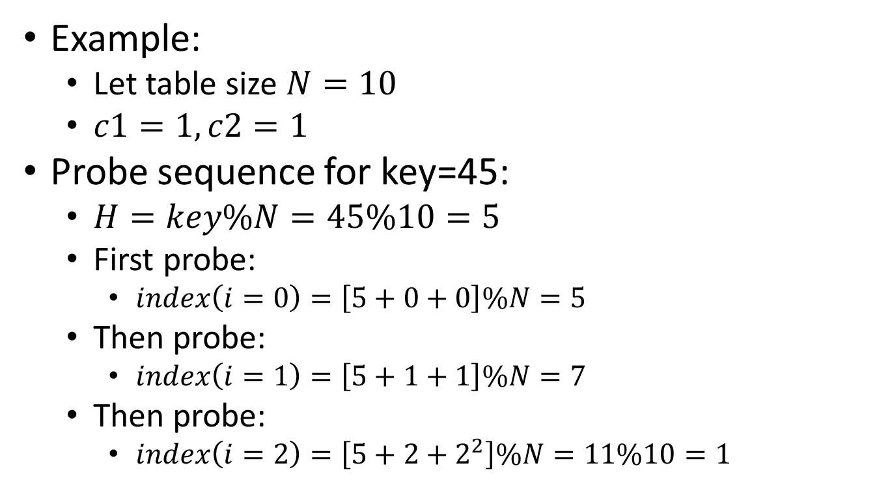
Quadratic probing
Example:
Let table size $N=10$
$c1=1, c2=1$
Probe sequence for key=45:
$H=key\%N=45\%10=5$
First probe:
$index\left(i=0\right)=\left[5+0+0\right]\%N=5$
Then probe:
$index\left(i=1\right)=\left[5+1+1\right]\%N=7$
Then probe:
$index\left(i=2\right)=\left[5+2+2^{2}\right]\%N=11\%10=1$

Slide 31
Direct Hashing
Can prevent collisions completely, if:
Table is large enough that every key gets its own index
Array index = key
A true O(1) data structure
Limitations of direct hashing
All keys must be non-negative integers
The hash table's size equals the largest key value plus 1, which may be very large
5
10
13
0 1 2 3 4 5 6 7 8 9 10 11 12 13

Slide 32
Hash Codes
How do we deal with non-integer keys?
Char
Strings
The goal of a hash function is to “disperse” the keys in an apparently random way

Slide 33
Hash Codes
ASCII code
A number for every character
“A” = 65; “B” = 66, “C” = 67, …, “Z”=90
“a” = 97; “b” = 98, “c” = 99, …, “z”=122

Slide 34
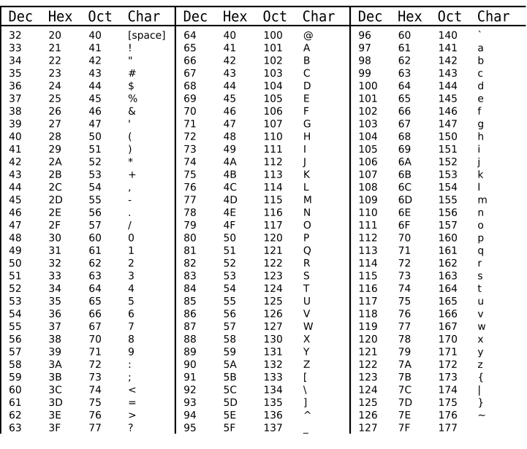
ASCII table

Slide 35
Hash Codes
Component sum
If the key is longer than an integer
Partition the key into components of fixed length (e.g., 16 or 32 bits) and sum the components (ignoring overflows)
Can we do this for strings?
“A” = 65
“AB” = 65 + 66 = 131
“ABE” = 65 + 66 + 69 = 200

Slide 36
Hash Codes
Component sum for strings
“A” = 65
“AB” = 65 + 66 = 131
“ABE” = 65 + 66 + 69 = 200
What is the issue?
Order does not matter
“RAMON” and “NORMA” have the same hash code

Slide 37
Hash codes
Polynomial accumulation
Again, split key into components (x₀, x₁ ,…)
But instead of just adding,
Treat components as the coefficients of a polynomial:
x₀a ^{k-1} + x₁a ^{k-2} +. . .+ x_{k-2}a + x_{k-1}
Easier to write code when rewritten like this:
x_{k-1} + a(x_{k-2} + a(x_{k-3} + . . . a(x₂ + a(x₁ + a x₀ )). . .))
“a” is some number
N | O | R | M | A
x₀ | x₁ | x₂ | x₃ | x₄

Slide 38
Hash codes
C++ implementation of Polynomial accumulation
size_t polynomial_hash (string word) {
const int a = 33;
size_t hash = 0;
for (int i = 0; i < word.size(); i++)
hash = hash*a + word[i];
return hash;
}

Slide 39
Hash codes
Polynomial accumulation
Especially suitable for strings
Choice of a = 33 gives at most 6 collisions on a set of 50,000 English words

Slide 40
Hash Codes
Integer cast
We reinterpret the bits of the key as an integer
Suitable for keys of length less than or equal to the number of bits of the integer type
byte, short, int, float in C++

Slide 41
hash table in C++
std::unordered_map
Usage similar to a map
“unordered_map containers are faster than map containers to access individual elements by their key, although they are generally less efficient for range iteration through a subset of their elements.”
#include <unordered_map>
using namespace std;
unordered_map<string,double> gpaRecord;
gpaRecord["Allen"] = 3.42; // new element inserted
gpaRecord["Beth"] = 3.5; // new element inserted
cout << gpaRecord["Allen"]; // existing element read

Slide 42
hash table in C++
std::unordered_map
Using the operator[key] automatically inserts (key, default value) if key is not found!
Same as in std::map
Check for key using find() and end iterator
#include <unordered_map>
using namespace std;
unordered_map<string,double> gpaRecord;
if (gpaRecord.find("Allen") != gpaRecord.end()) {
cout << gpaRecord[“Allen"];
}

